Slide 1
Software Engineering and Architecture
Server Threading

Slide 2
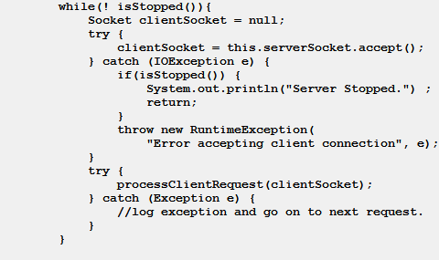
Motivation
Servers are reactive
Process incoming requests for clients
… and if we are successful there are many clients…
Accept connection
Process request
Goto 1

Slide 3
Exercise
What happens in the single-threaded server if
A) A new request arrives before the last was processed?
B) One of the requests takes 45 seconds to complete?

Slide 4
Motivation
This is problematic if
A new request arrives before the last was processed
The request process is slow to compute
Accept connection
Process request
Goto 1

Slide 5
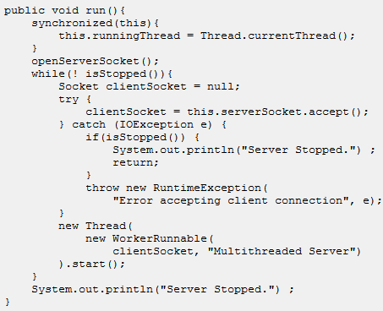
One Solution
The classic solution is the thread-per-request
That is, every request creates a new thread
Accept connection
Spawn new thread
Goto 1
The thread then concurrently process the request!

Slide 6
Exercise
What happens in the multi-threaded server if
A) A new request arrives before the last was processed?
B) One of the requests takes 45 seconds to complete?

Slide 7
All Well Then?
Classic teaching tells us that
Thread creation is expensive
slow and require much memory
Thread context switching is expensive
Slow to switch from thread 1 to thread 87
Thus, if our server is hit by 10.000 requests in 1 second, it will become sluggish…
Note: Maybe classic teaching is not true!!!

Slide 8
Availability Teaching
Maybe, maybe not; but anyway
If the number N of incoming requests is high you get
N concurrent threads struggling for CPU time
They are all very slow
May run out of memory!
Meaning the server will simply crash
Quite fun experiment to make!
Java VM will terminate when 95% CPU time is spent on GC
A Low Availability Server ☹

Slide 9
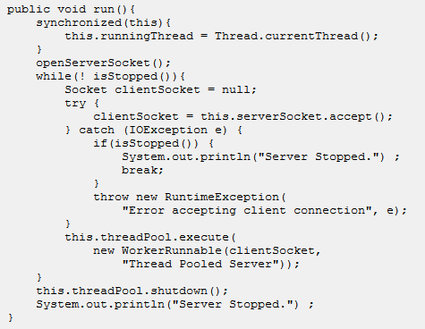
Another Take
The alternative solution is the Thread-Pooled-Server
Accept connection
Queue request for next idle thread
Goto 1
Ten threads then concurrently process the requests!

Slide 10
Exercise
What happens in the thread-pooled server if
A) A new request arrives before the last was processed?
B) One of the requests takes 45 seconds to complete?

Slide 11
Discussion
Thread pooled servers have characteristics that are important for high availability server construction
More responsive as seen from the client
Instead of 10.000 requests at time t1 and then 20.000 at t2, the thread pool will guaranty that at most 2.000 requests are handled
That is, (theoretically) 10 times faster processing at time t2
Protection against crashing due to out-of-memory
The pool size can be adjusted to the amount of memory available
(Give and take, if all requests are of the ‘eat memory’ type…)
Queue characteristics means bursts are handled
Bursts (sudden steep increase of requests) are handled by graceful degradation
Server comes slower but then catches up again; does not crash…

Slide 12
And…
Jetty (= Spark-Java’s engine) is thread pooled
Initially with a pool of 8 threads, extending up to 200 threads
Can be configured to other values…

Slide 13
Similar Experiment
I did energy efficiency experiments on a case study pizza ordering system
Orders and inventory stored in MariaDB SQL database
The SQL code was inspired by online tutorials
Coding by googling ☺
Open connection, make query, close connection
Results: 350 tps and average response time: 1.100 ms
Then rewrote into connection pool (C3P0) code
Get connection from pool, make query, return connection to pool
Results: 1.400 tps and average response time: 64 ms

